Slide 1
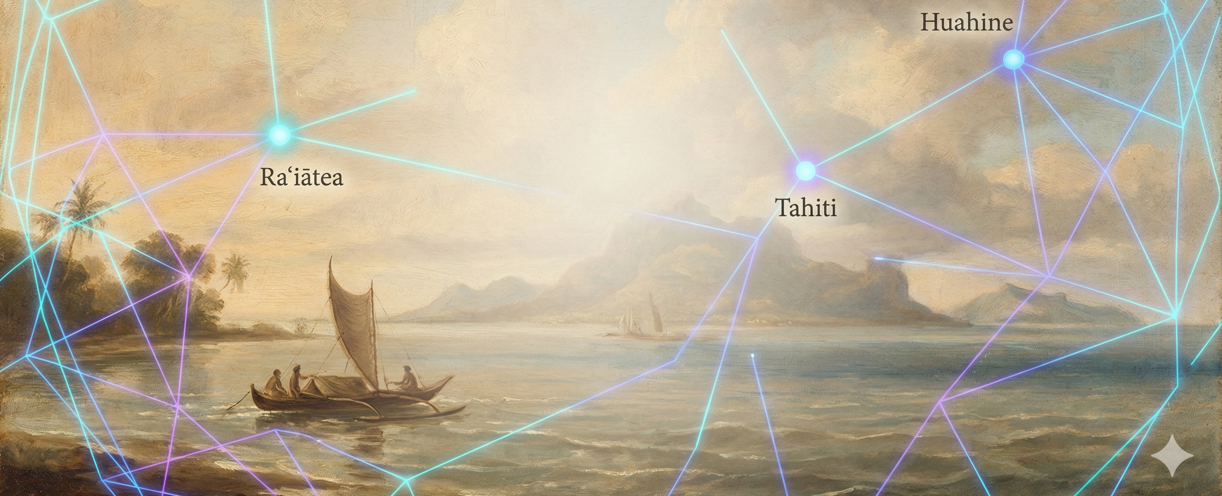

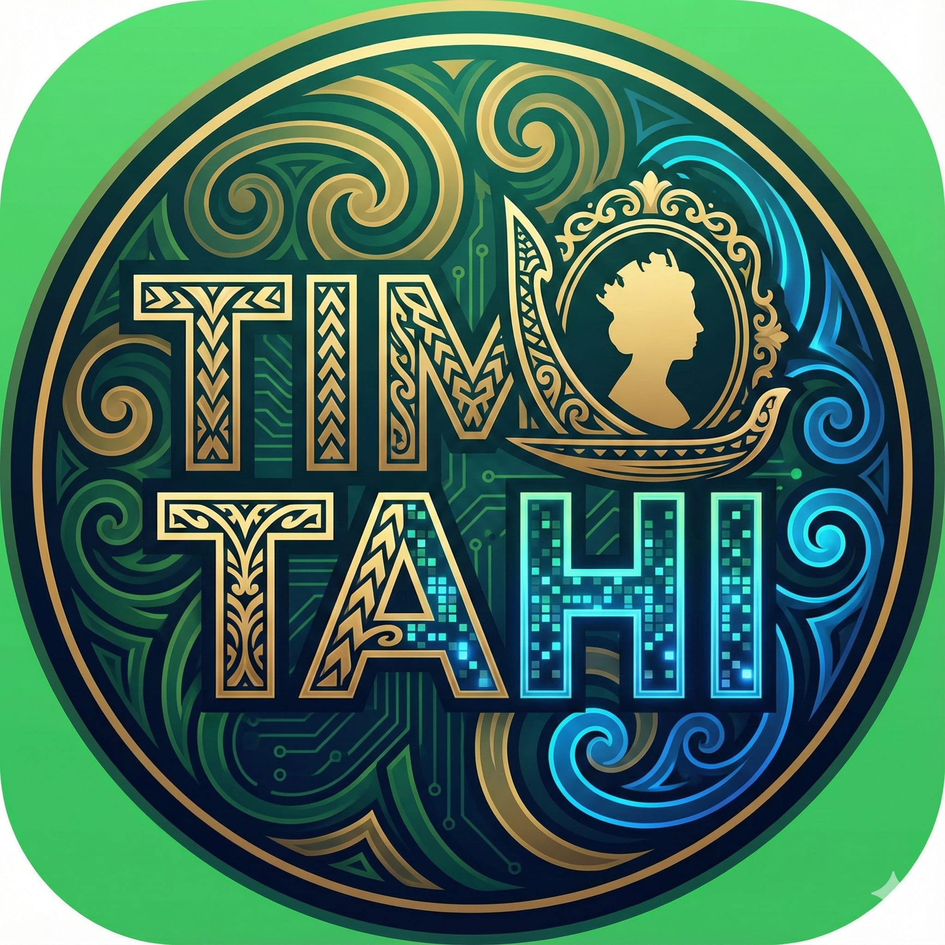
Tau o Mai
Journeys with Mai
Islands of Connection
A Digital
Narrative Experience
for Young People
Presented by:
Tima Tahi (Team One)

Slide 2
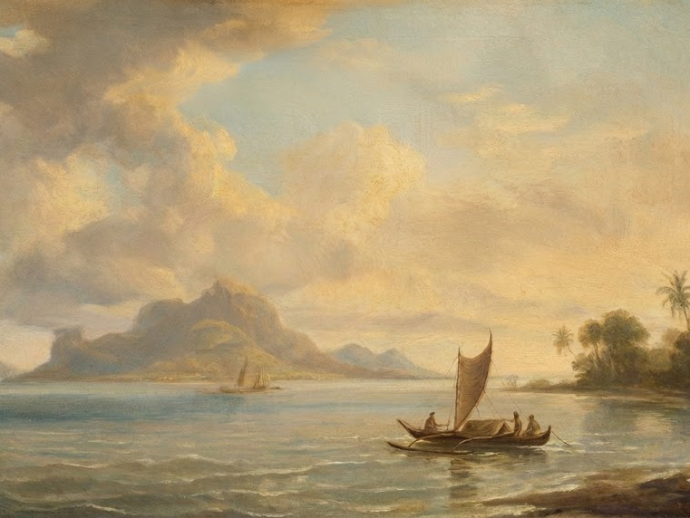

The Opening Strand of Tapa

Slide 3
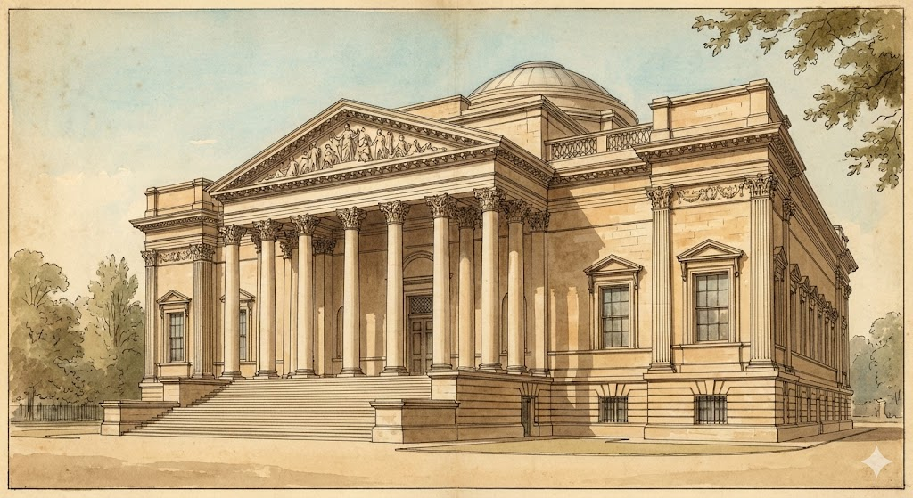
A Journey in Four Acts
Act One – The Encounter
Act Two – The Displacement
Act Three – The Return
Act Four – The Reconnection

Slide 4
Animation?

Slide 5
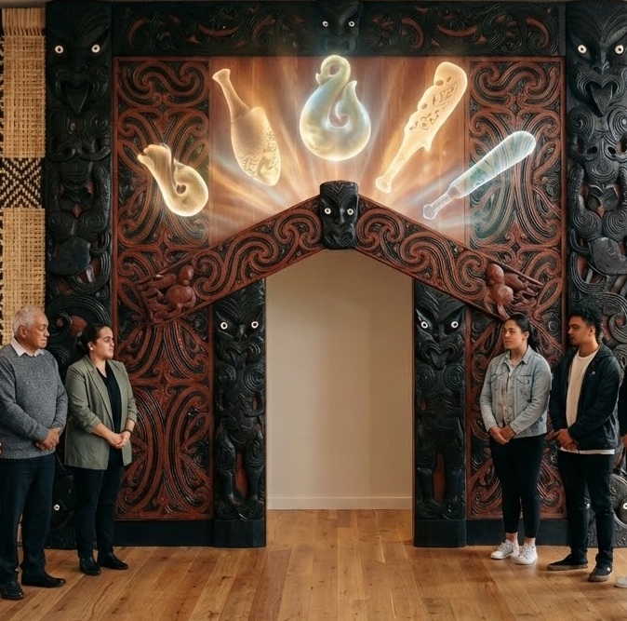
Open the portal: Karakia
Whakataka te hau ki te uru
Whakataka te hau ki te tonga
Kia mākinakina ki uta
Kia mātaratara ki tai
E hī ake ana te atakura
He tio, he huka, he hau hū
Tīhei mauri ora!

Slide 6
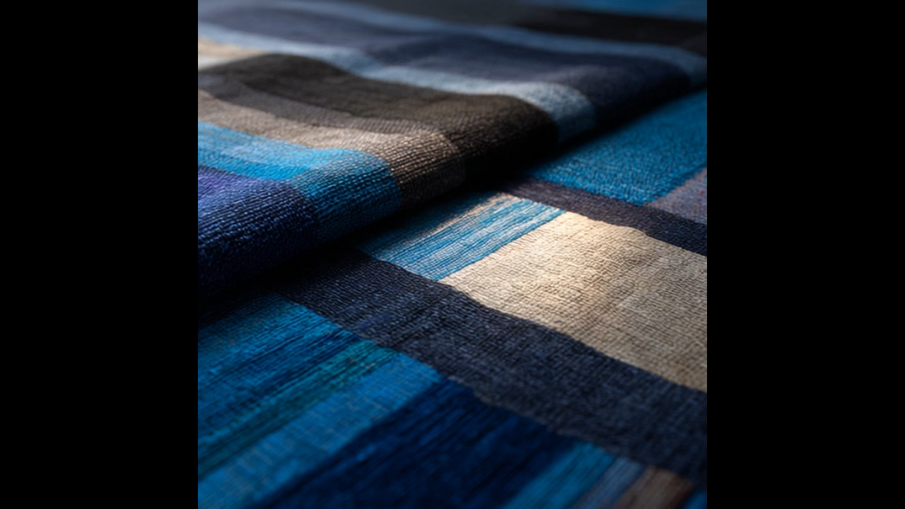
The Fonts in the Slide Deck
Bondoni MT
Century Gothic

Slide 7
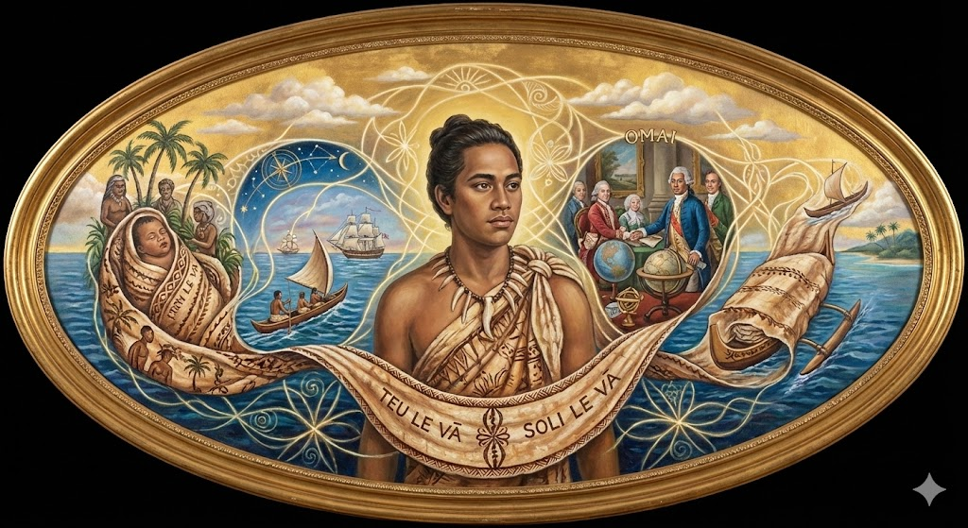
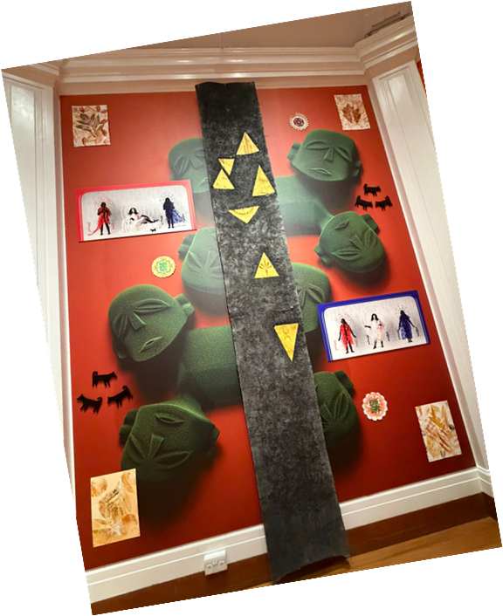
The Thread that Connects Us

Slide 8
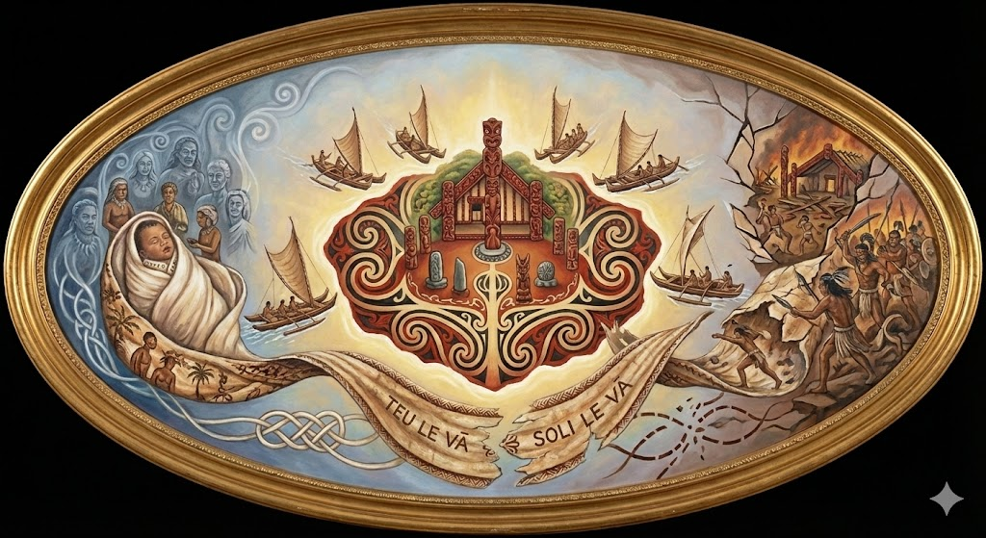
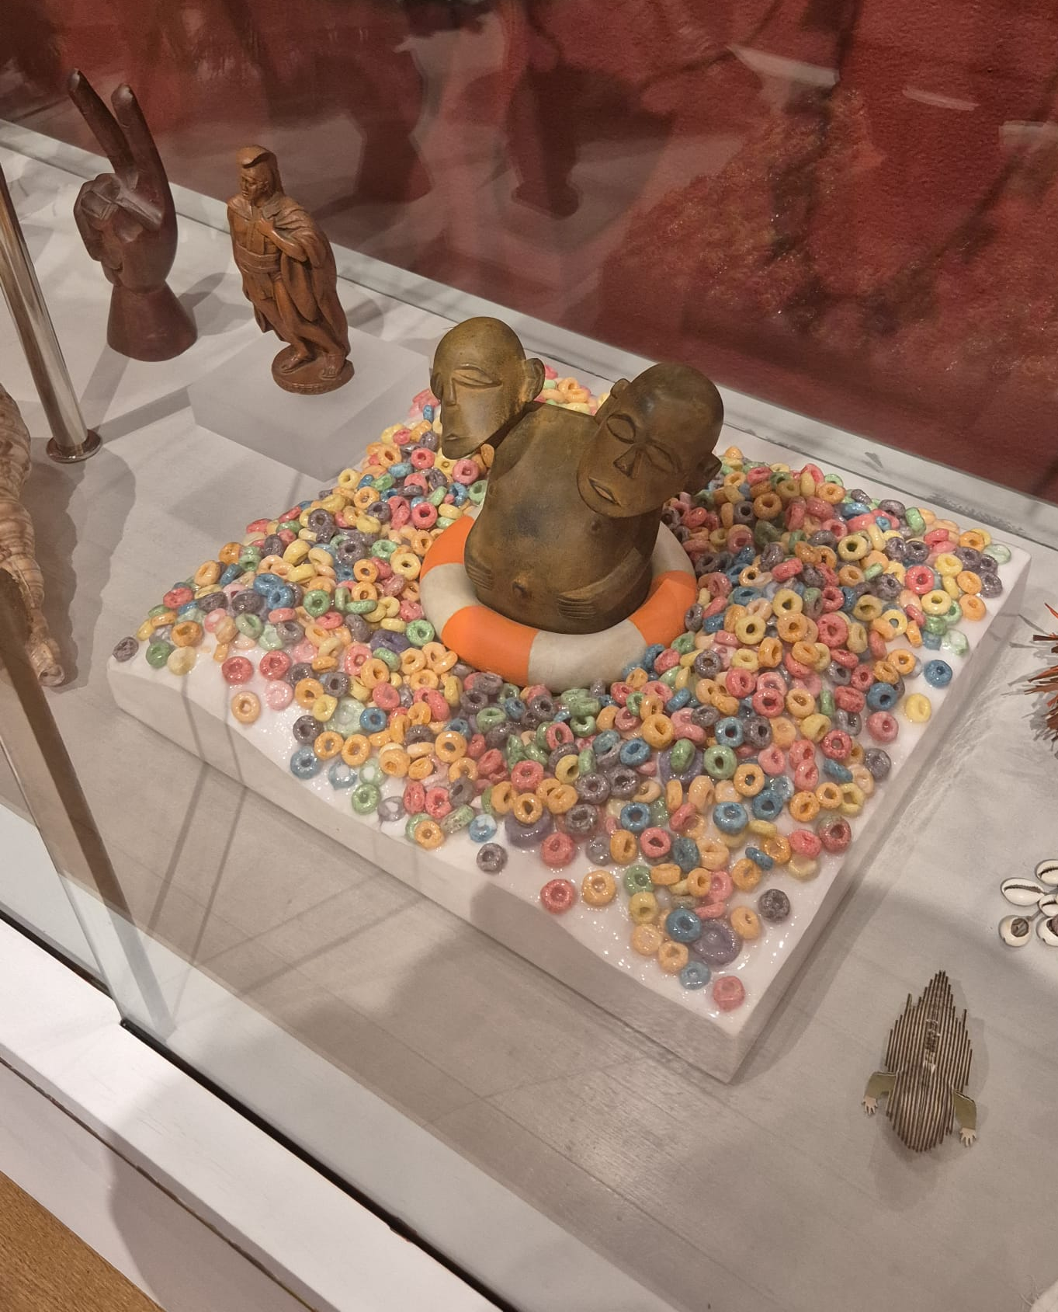
Act 1 – The Encounter

Slide 9
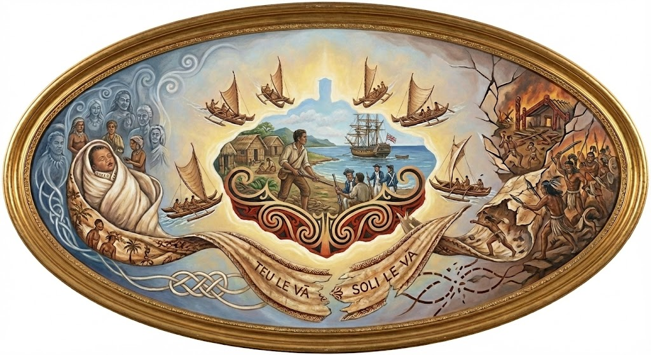
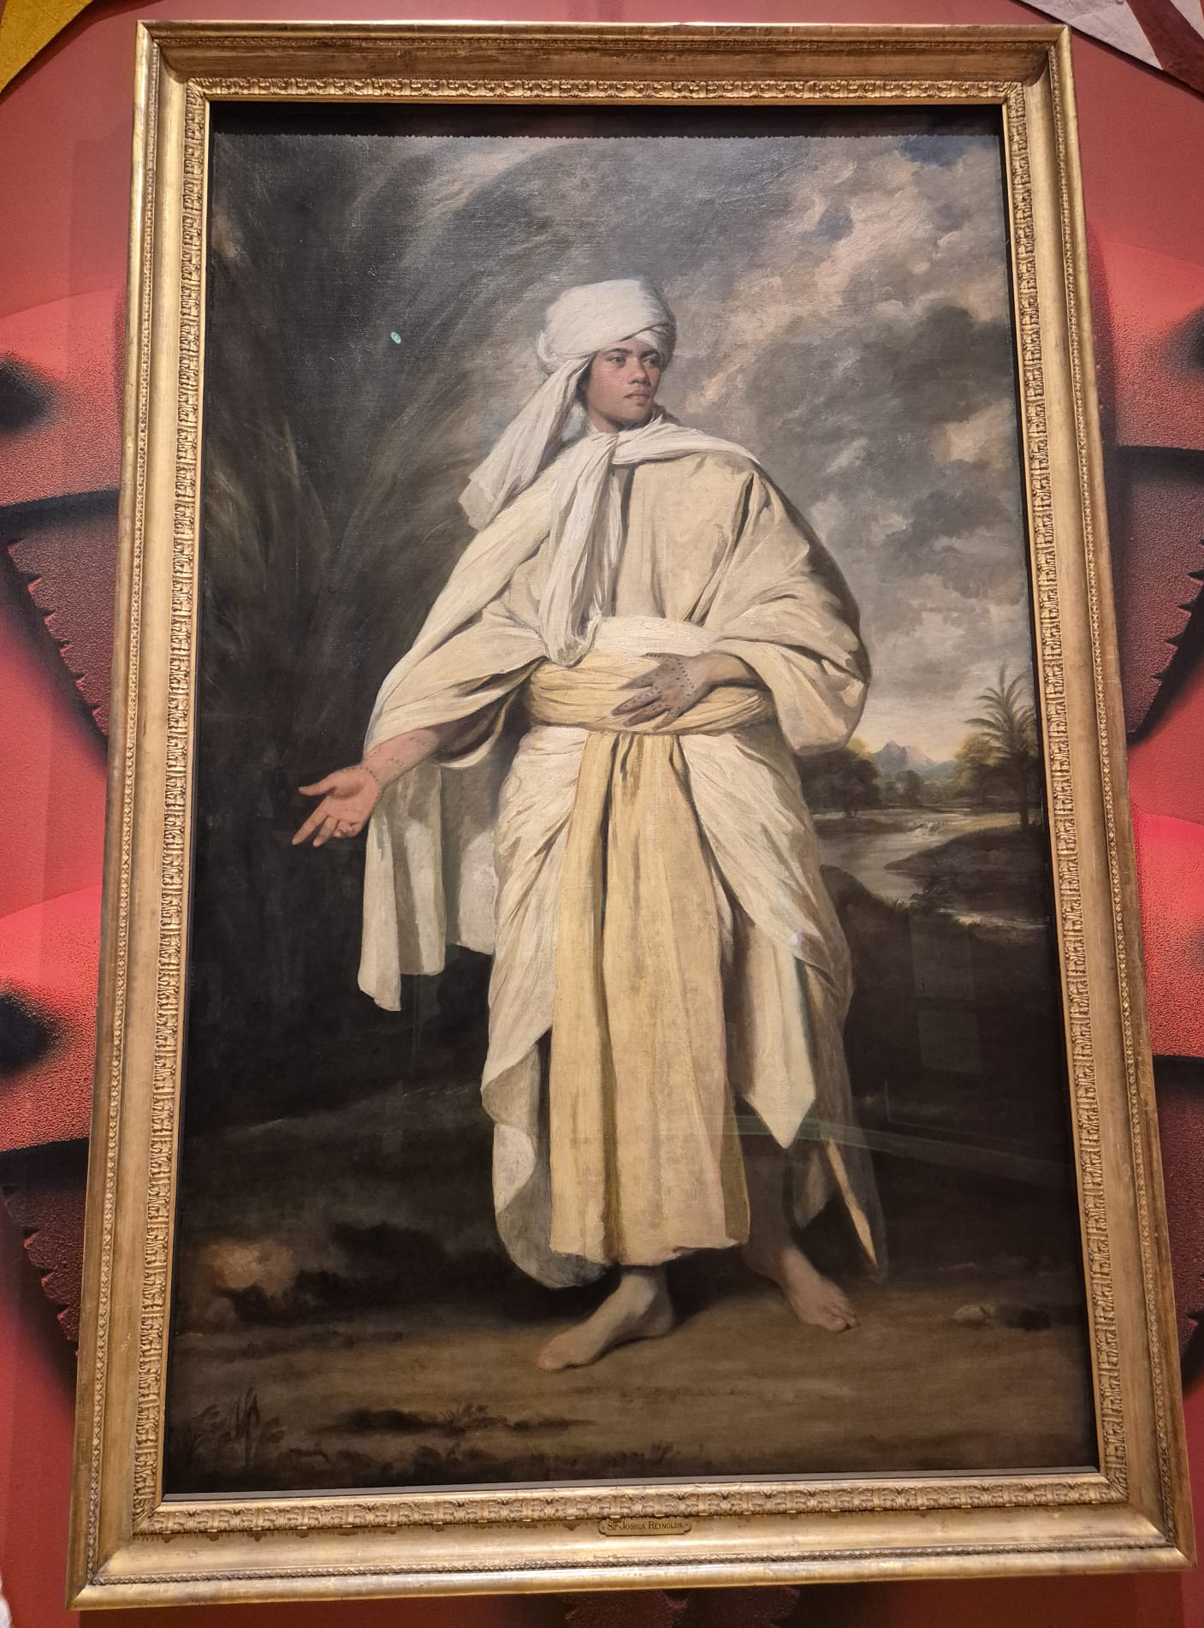
Act 2 – The Displacement

Slide 10
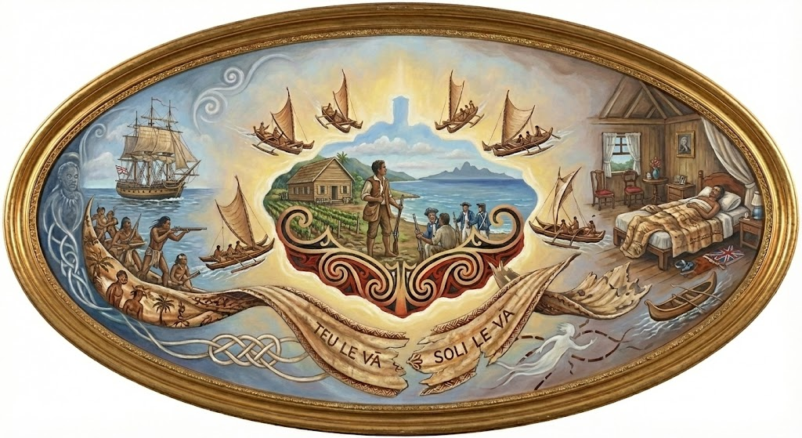
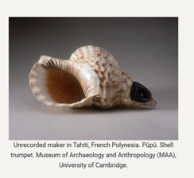
Act 3 – The Return

Slide 11
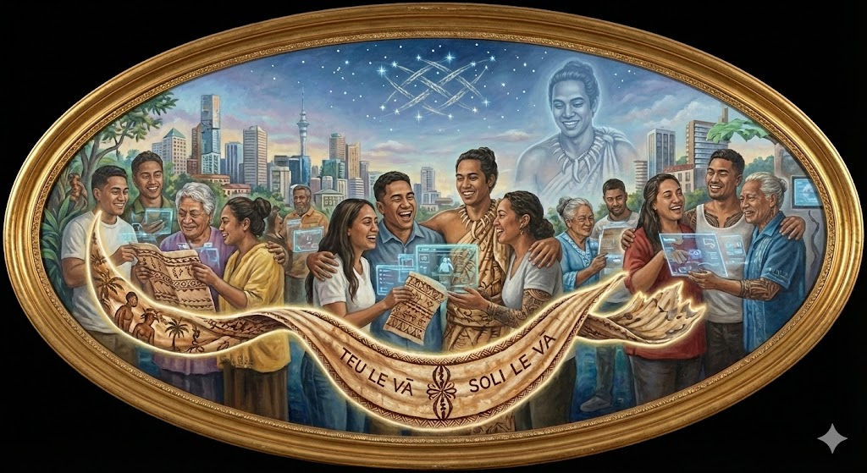
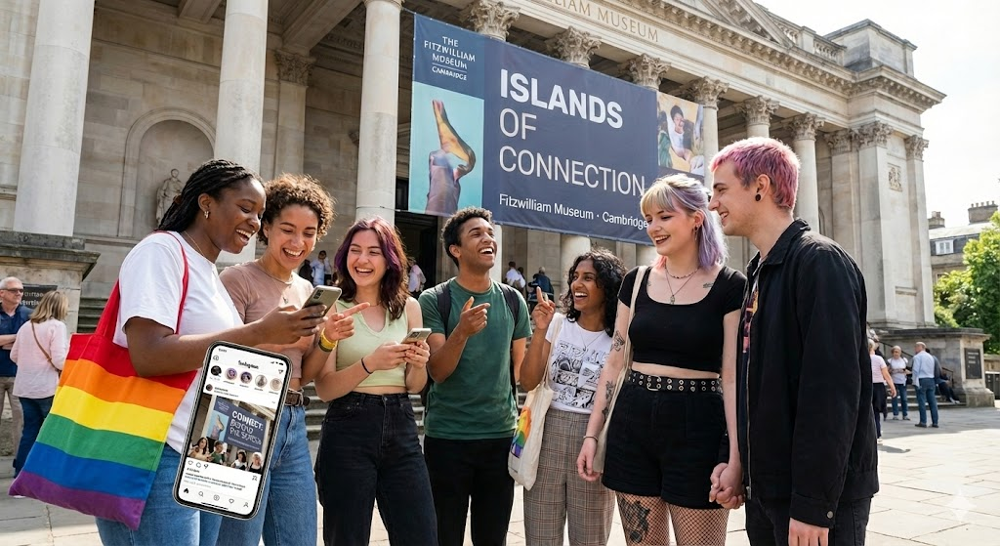
Act 4 – The Reconnection

Slide 12
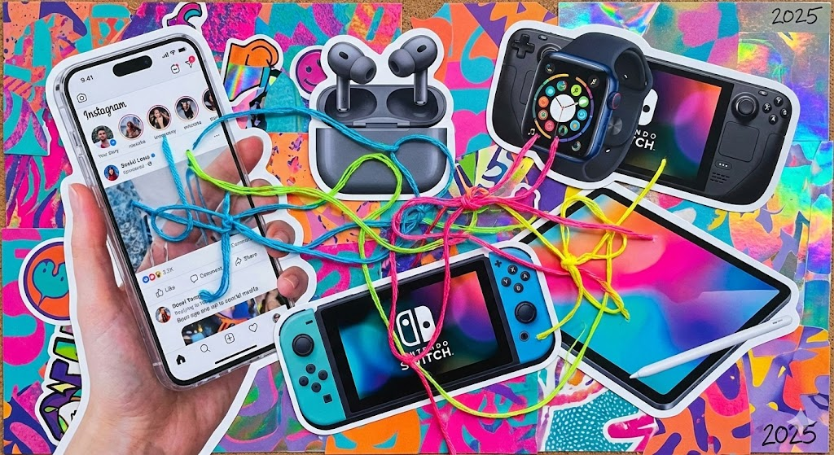
What Connects You to the World?
Who connects you to the world?
What stories are written on you?
How will you nurture the space between you and the people you meet?

Slide 13


Closing the
Portal

